Slide 1

Hospital Training Overview
Notes:
Login into IPM by accessing the URL www.blacktiemedical.com. Each vendor is given their own unique username and password. Once the information is entered, click “Login”.

Slide 2
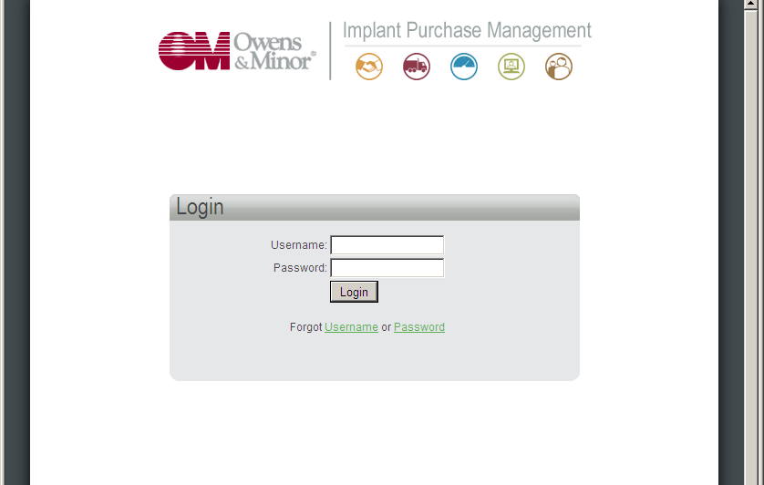
Login into IPM by accessing the URL https://ipm.owens-minor.com/. Each user is given their own unique username and password. Once the information is entered, click “Login”.
Notes:
Login into IPM by accessing the URL www.blacktiemedical.com. Each vendor is given their own unique username and password. Once the information is entered, click “Login”.

Slide 3
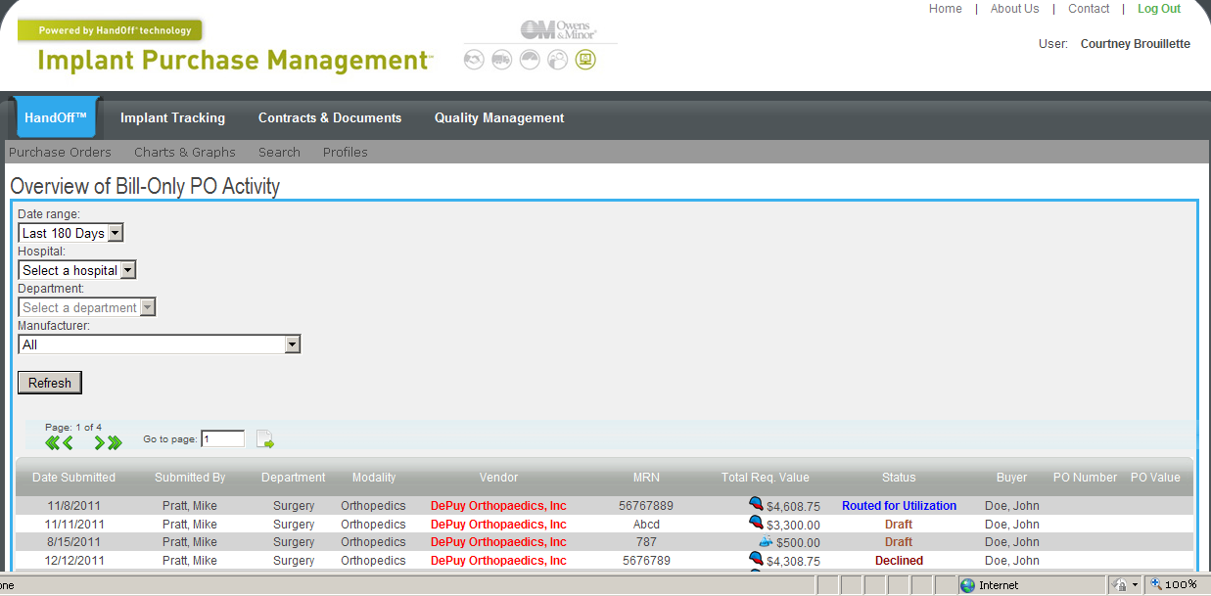
Once you are logged in, you are directed to the Overview of Bill-Only PO Activity page, which shows all pending and completed PO requests for your department. To filter your transactions, you can use the drop down menus in the upper left to dictate the date range , hospital and department that you would like to view.
Notes:
Once you are logged in, you are directed to the Overview of Bill-Only PO Activity page which shows all pending and completed PO requests for your department. To filter your transactions, you can use the drop down menus in the upper left to dictate the date range , hospital and department that you would like to view.

Slide 4
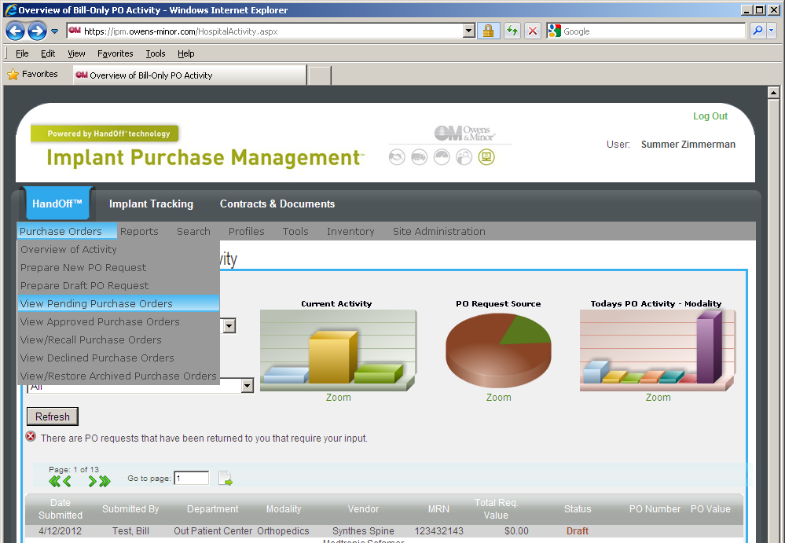
Approving a Bill Only PO Requisition
To approve a Bill Only PO, move your cursor over the Purchase Orders menu and select View Pending Purchase Orders.
Notes:
Approving a Bill Only PO Requisition
To approve a Bill Only PO, move your cursor over the Purchase Orders menu and select View Pending Purchase Orders.

Slide 5
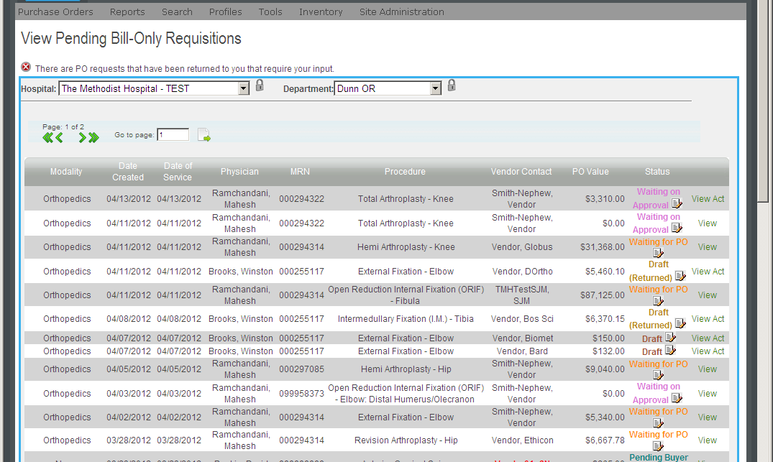
Approve a PO Requisition
After selecting Hospital & Dept, you will see all PO’s that are awaiting an action before they are complete. You can see the status of the PO by looking to the “Status” column on the far right of the screen. If the PO is awaiting an action from another user, you will only see the “View” link. If the PO is awaiting an action from you as the user, you will the see the “Act” link to the right of the status. Click the “Act” link to open the approval screen.
Notes:
You have started a new PO Requisition For Products page. Here you will begin to input some basic information about the case. Use the drop down menus to populate the appropriate fields. You will notice a lock icon next to the drop down menus. If you click on the icon, it will default to the selection each time you log into IPM.

Slide 6
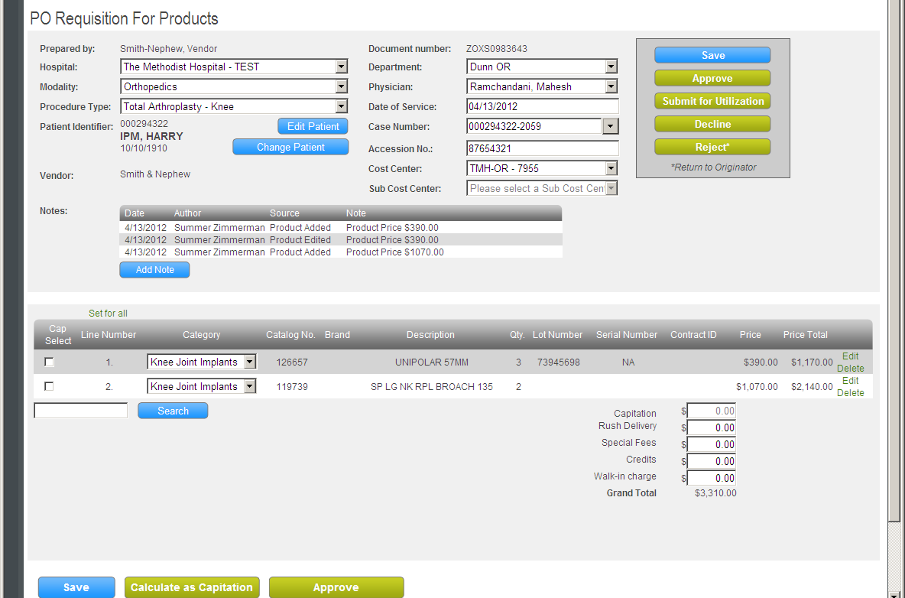
PO Approval Screen
Review the department and patient information on the PO Requisition and verify it is correct.
Verify Products & Capitations (if any)
Check to see the correct products, as well as any possible capitations, are listed.
Notes:
The Date of Service field is automatically time stamped for the current date that PO Requisition was created. You can enter the Patient Identifier (13 digit Acct #) and hit ENTER/TAB to look up the patient. The Patient No./Case No. field is where you will input the OR Manager Case Number.

Slide 7
First Approver
The First Approver will be able to click on: “Approve” - to forward to Second Approver
“Submit for Utilization” – to send an email to a user-specified person asking for input on whether or not the product(s) were used or not used
“Decline” - to refuse PO Requisition and end this PO Req process
“Reject” - to send PO Requisition back to Vendor for adjustment; comments can be made
Category
Note that Category is required for each item chosen.
Notes:
The Date of Service field is automatically time stamped for the current date that PO Requisition was created. You can enter the Patient Identifier (13 digit Acct #) and hit ENTER/TAB to look up the patient. The Patient No./Case No. field is where you will input the OR Manager Case Number.

Slide 8
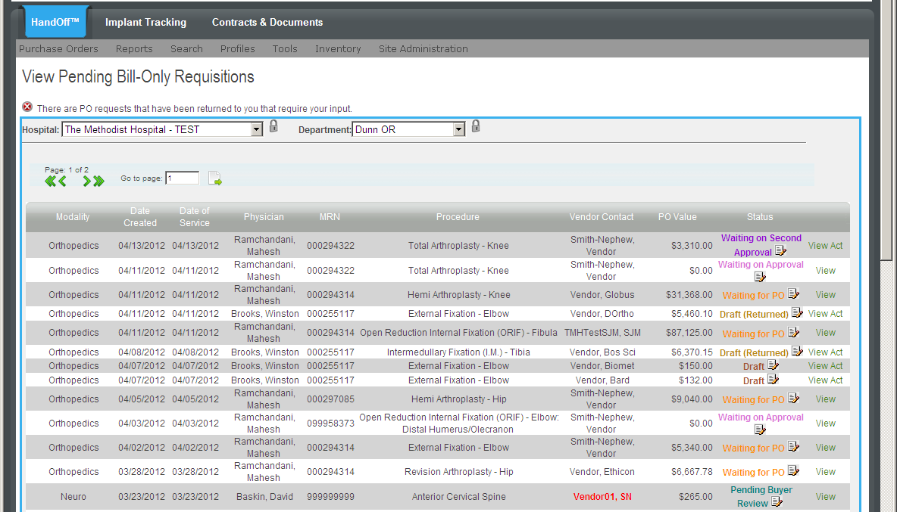
Second Approver to Approve a PO Requisition
After selecting Hospital & Dept, you will see all PO’s that are awaiting an action before they are complete. You can see the status of the PO by looking to the “Status” column on the far right of the screen. If the PO is awaiting an action from another user, you will only see the “View” link. If the PO is awaiting an action from you as the user, you will see the “Act” link to the right of the status. Click the “Act” link to open the approval screen.
Notes:
Adding Product to the PO Requisition
After the basic case information has been entered, you can add products that were utilized during the case. In the lower left corner, you will notice a product Search box. Simply enter the catalog number of the first product that was used and then click Search.

Slide 9
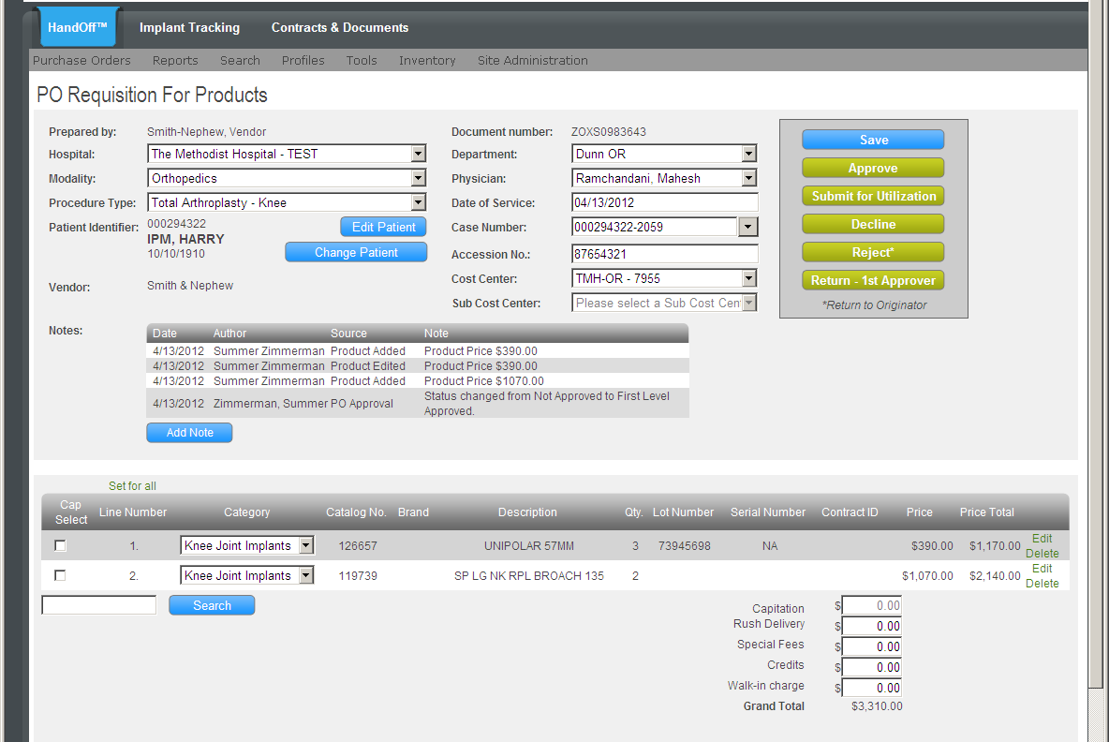
Second Approver
The Second Approver will be able to click on: “Approve” - to forward to Third Approver
“Submit for Utilization” – to send an email to a user-specified person asking for input on whether or not the product(s) were used or not used
“Decline” - to refuse PO Requisition and end this PO Req process
“Reject” - to send PO Requisition back to Vendor for adjustment; comments can be made
“Return - 1st Approver” - to send the PO Requisition back to the 1st Approver for further review
Notes:
Adding Product to the PO Requisition
After the basic case information has been entered, you can add products that were utilized during the case. In the lower left corner, you will notice a product Search box. Simply enter the catalog number of the first product that was used and then click Search.

Slide 10
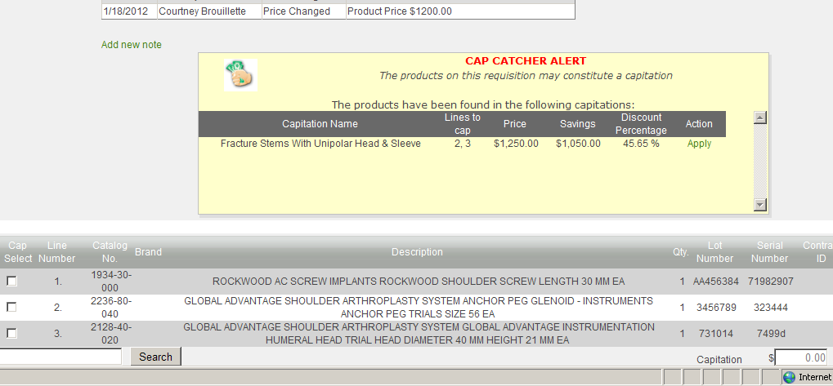
If a Capitation applies, the Cap Catcher Alert may show on the screen.
Applying a Capitation
When groups of products qualify for a capitation, IPM will prompt you with the Cap Catcher Alert. It notifies you that certain products added to the PO Requisition may qualify as a capitation.
Notes:
Applying Capitation
When groups of products qualify for a capitation, IPM will prompt you with the Cap Catcher Alert. It notifies you the certain products that have been added to the PO may qualify as a capitation.

Slide 11
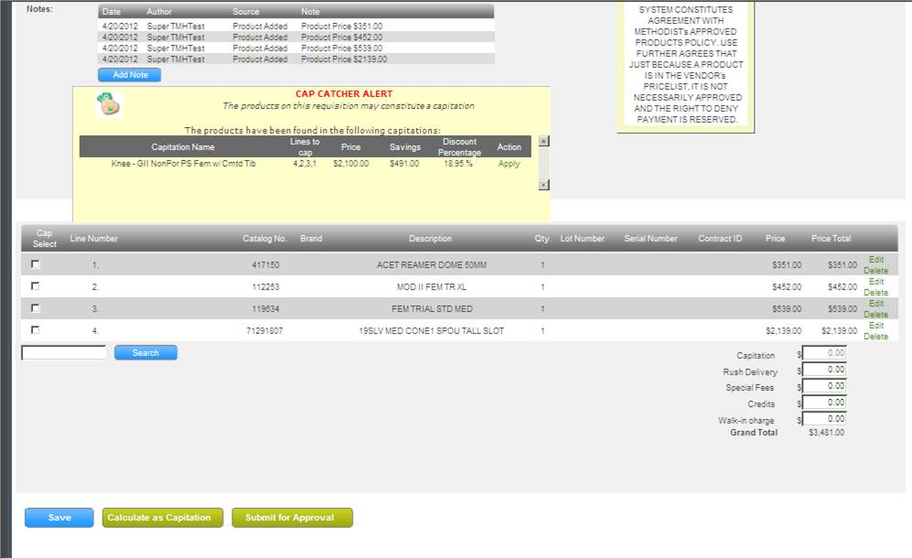
To apply a capitation, click either the Apply link next to the suggested capitation or click the check boxes next to products to include in the capitation. If choosing the latter, click the Calculate as Capitation button in the lower left corner. From here you will be able to search for existing capitations that have been pre-loaded, added or maintained in IPM by the Hospital. You can enter any Rush Delivery charges or Special Fees using the input boxes in the lower right.
Depending on whether the PO is in a state of final approval or needs approval by a higher level approver, to complete the PO Requisition click either Approve or Submit for Approval.
Notes:
Applying Capitation
When groups of products qualify for a capitation, IPM will prompt you with the Cap Catcher Alert. It notifies you the certain products that have been added to the PO may qualify as a capitation.

