Slide 1
Vendor Training Overview

Slide 2
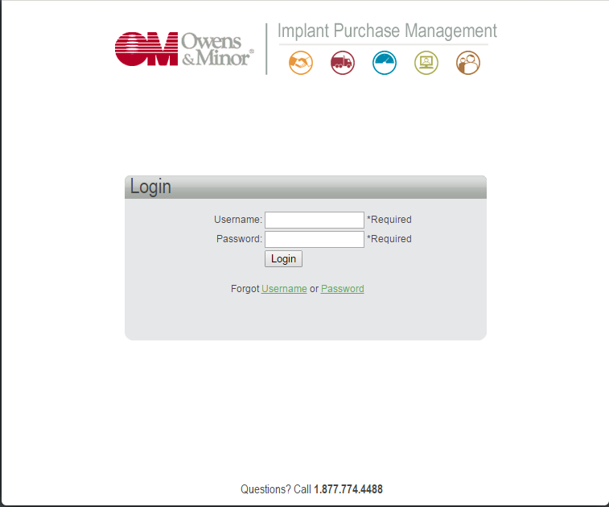
Welcome to IPM
Login into IPM by accessing the URL https://ipm.owens-minor.com/.
Each vendor is given their own unique username and password. Once the information is entered, click “Login”.

Slide 3
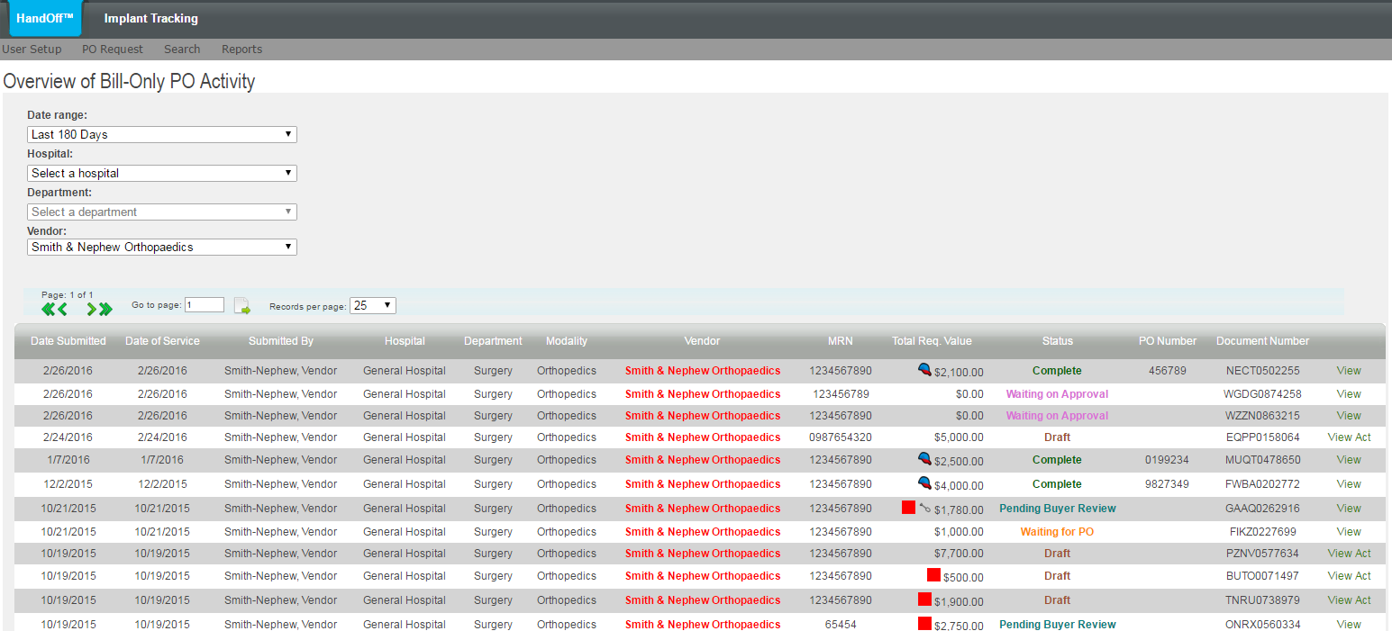
Once logged in, you are directed to the Overview of Bill-Only PO Activity which shows all pending and completed PO requests for your login ID.
To filter your transactions, you can use the drop down menus in the upper left to dictate the date range and hospital that you would like to view. Each column heading can be sorted.

Slide 4
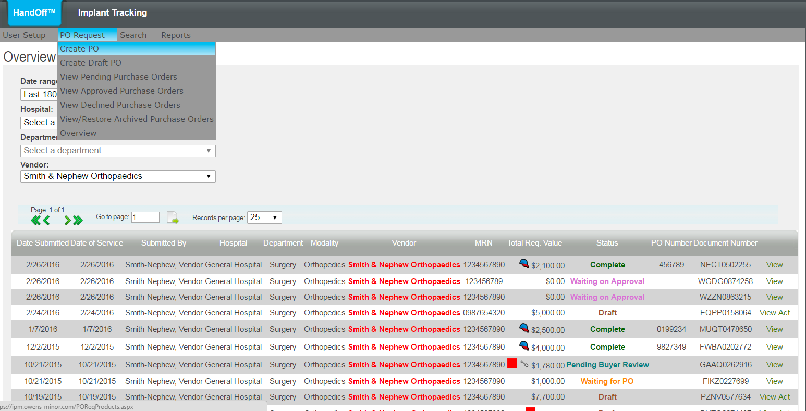
The first step is to create a new PO Requisition For Products.
This is started underneath the PO Request Menu by selecting Create PO.

Slide 5
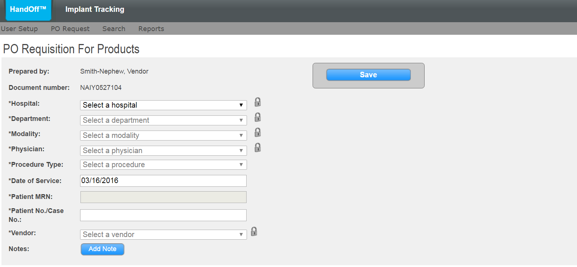

You have started a new PO Requisition For Products page.
Here you will input basic information about the case. Use the drop down menus to populate the appropriate fields.
You will notice a lock icon next to the drop down menus. If you click on the icon, it will default to the selection each time you log into IPM.

Slide 6
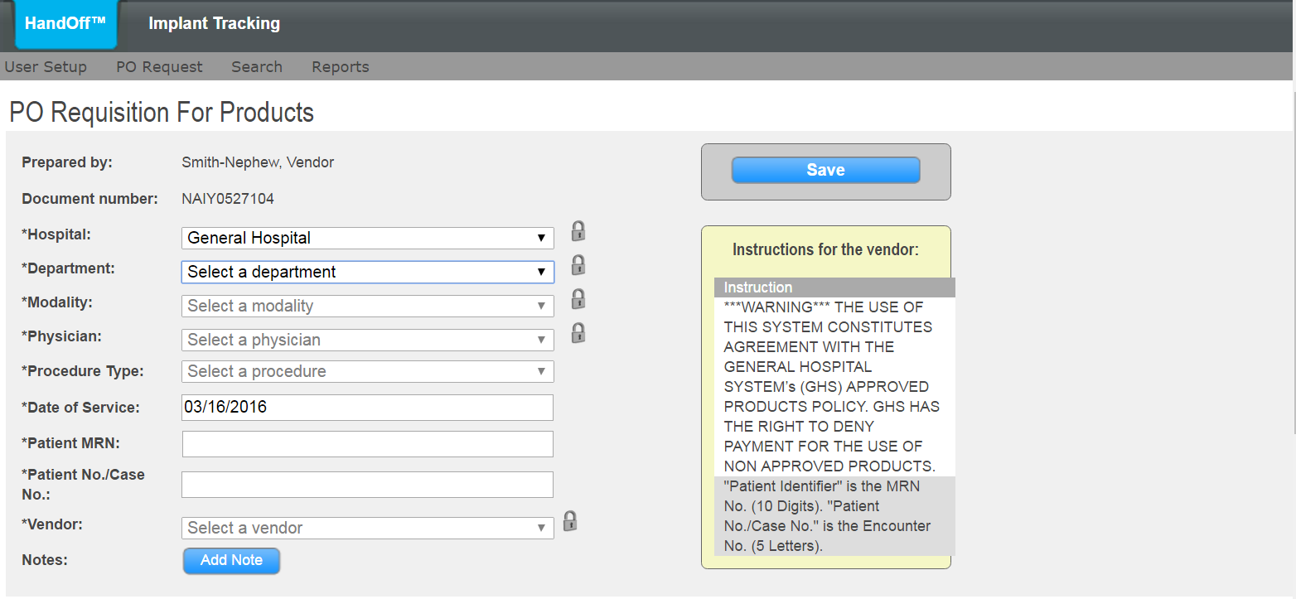
Select the Hospital: field and special Instructions for the Vendor from the hospital are shown. These will help guide you through the process as well as give you additional information as needed.

Slide 7
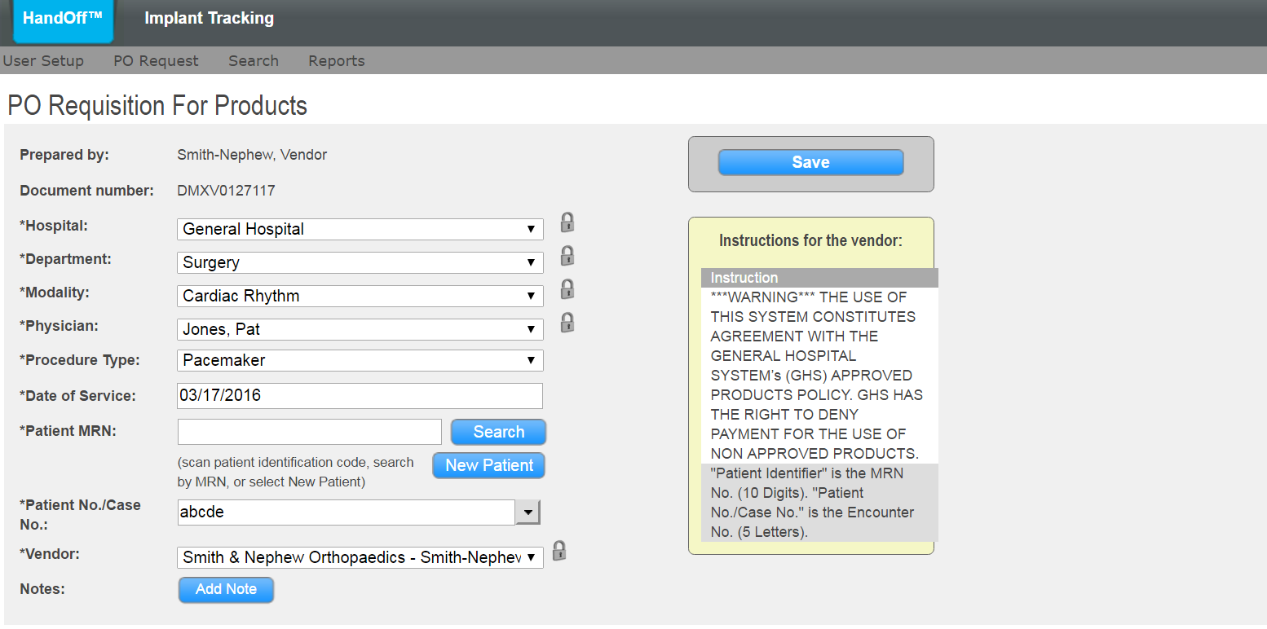
If the hospital has chosen to send their patient information to IPM, enter the MRN and hit ENTER/TAB or click SEARCH to look up the patient.
If the patient is new, click “New Patient”. Otherwise, type in the MRN and Case Number as instructed.

Slide 8
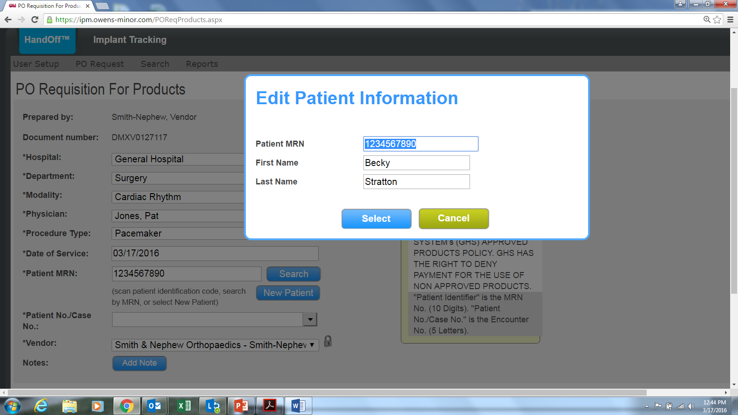
The Edit Information pop-up screen allows you to add or verify the patient information.

Slide 9
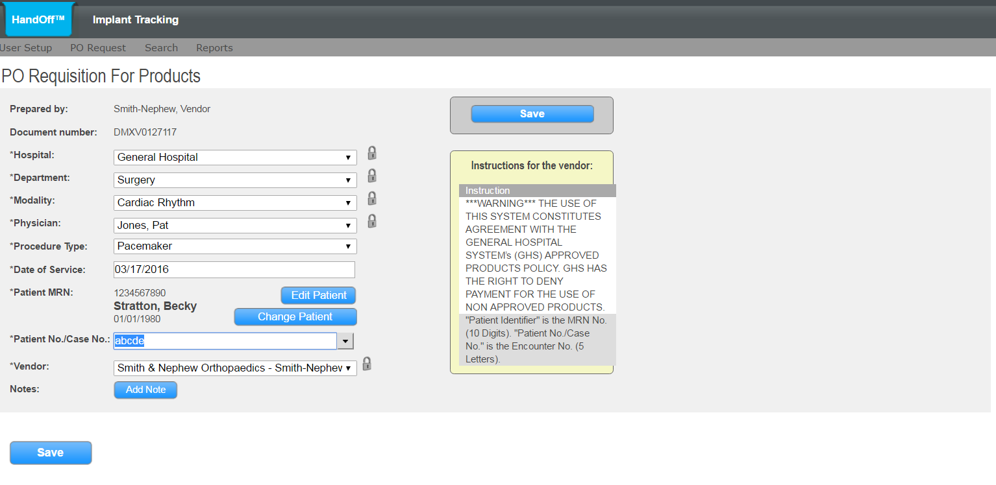
The Patient Case (sometimes used as the OR IS System Case Number) is entered in the Patient No./Case No. field. This might be auto-populated after selecting the patient if the hospital sent the patient information to IPM

Slide 10
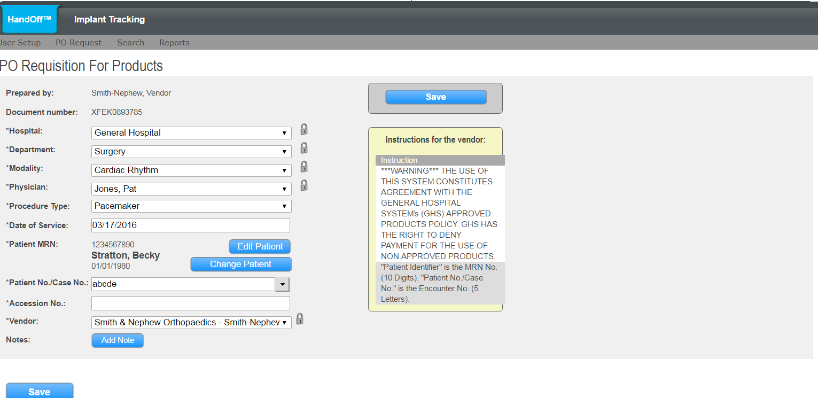
If present, the Accession No. field is an additional field for patient information. The exact placement of patient criteria in these fields will be listed by Hospital under “instructions”. Once you have populated all the required information, click “Save”.

Slide 11
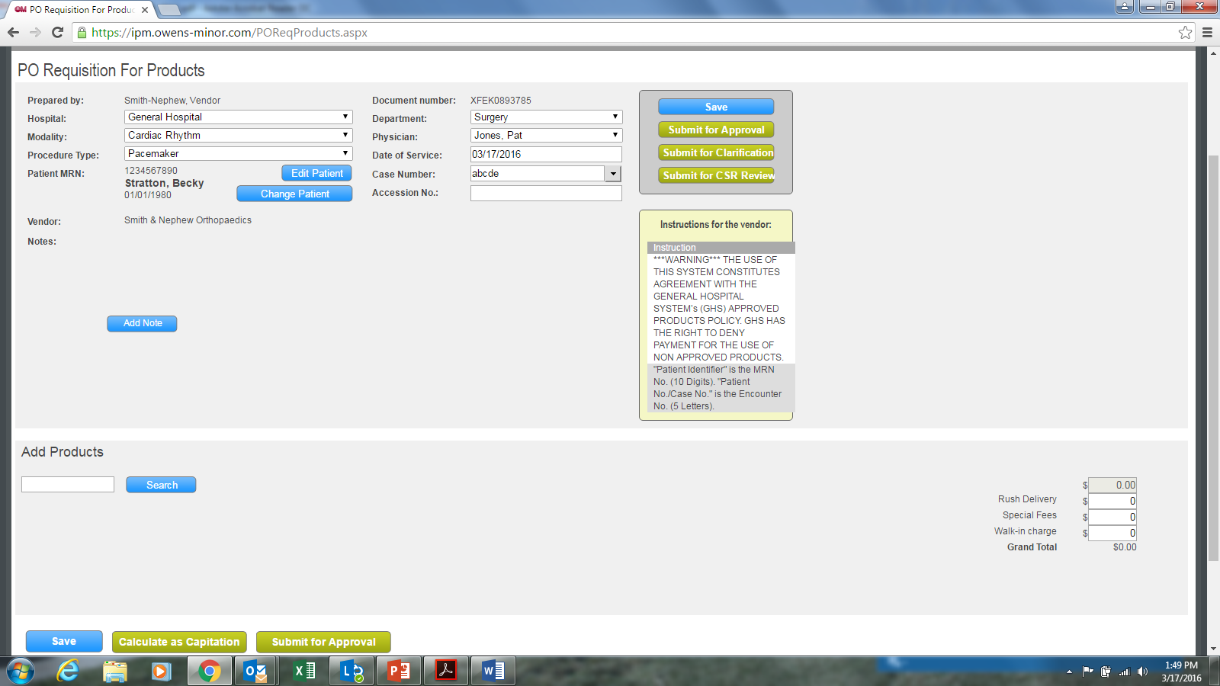
Adding Product to the PO Requisition
After the basic case information has been entered, you can add products that were utilized during the case. In the lower left corner, you will notice a product Search box. Simply enter the catalog number of the first product that was used and then click Search.

Slide 12
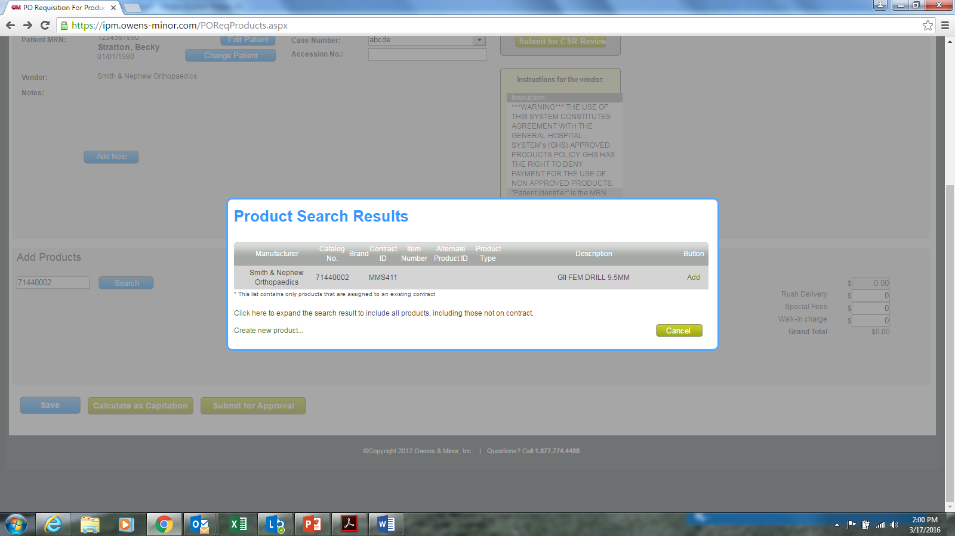

Slide 13
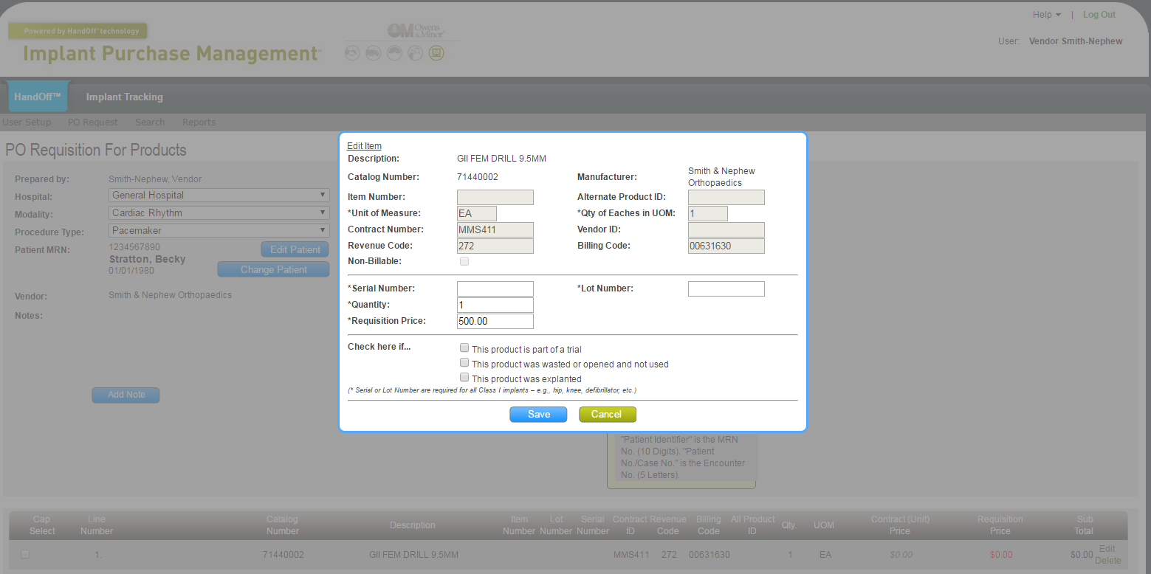
The Edit Item window is for entering product specific information.
When finished, click Save to add the product. Continue adding each product until finished.
NOTICE: If a product was part of a Trial, it was Wasted or Opened and not used, or the product was explanted (In & Out), use the appropriate check box to denote the circumstance. For these items, your contract may call for a reduced rate to be applied.

Slide 14
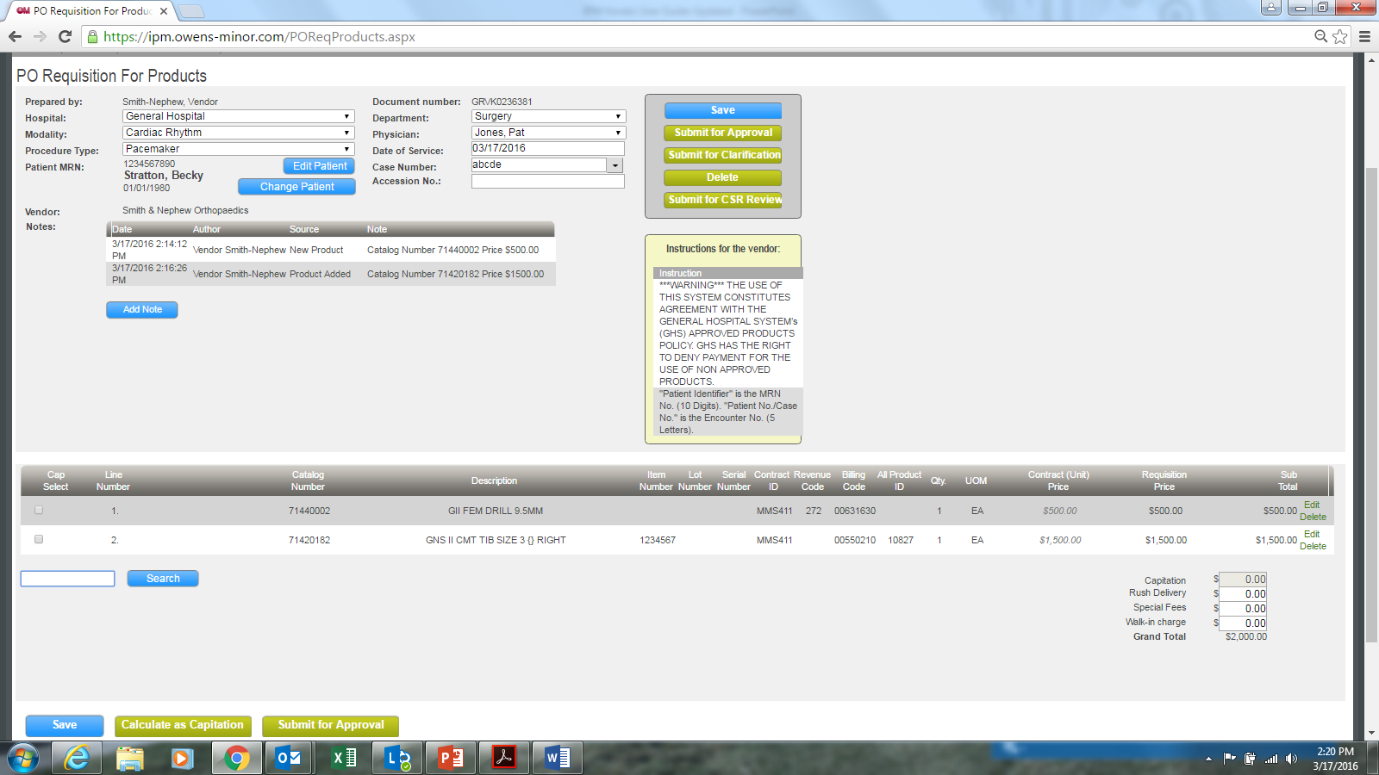

Slide 15
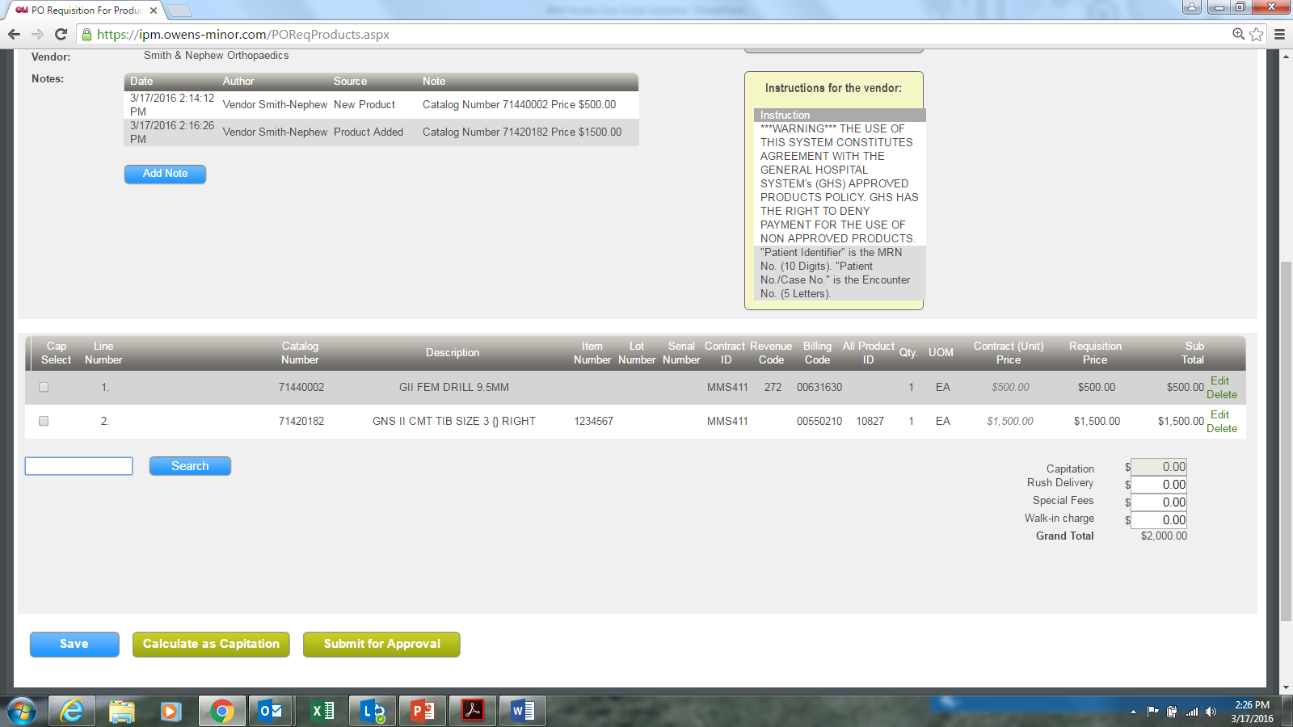
Applying a Capitation
IPM allows you to apply a Capitation for the products that qualify. Simply select the product in the Cap Select column and click on Calculate as a Capitation. You will be able to apply the capitation on these products. Continue by now adding other products that might be outside the capitation.

Slide 16
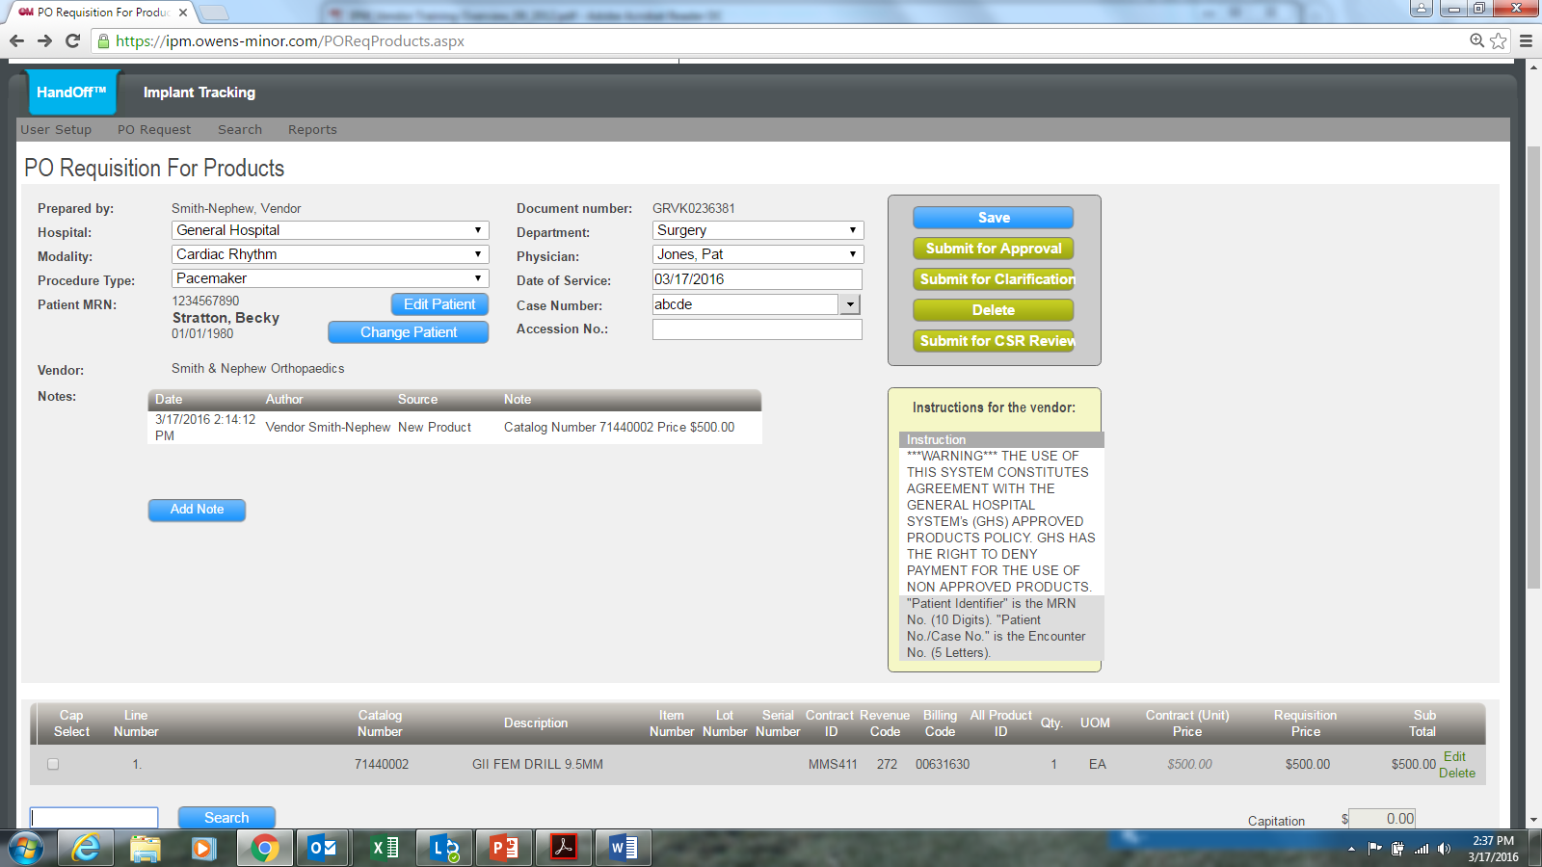
The Buttons perform the following functions:
Save | Preserves your work as a draft but does not move the PO into the approval workflow
Submit for Approval | Moves the PO Requisition into the approval process by sending an email to the first hospital approver for review.
Submit for Clarification | Allows you to submit the PO for further clarification on PO Requisition without moving it into the approval process. You are abled to enter an individual's email address along with attaching a note to outline what needs clarification.
Delete | Removes the PO from IPM. There is no way to retrieve a deleted PO. You must recreate a new PO requisition if the Delete button is used.
To complete the PO Requisition, click “Submit for Approval” button.

Slide 17
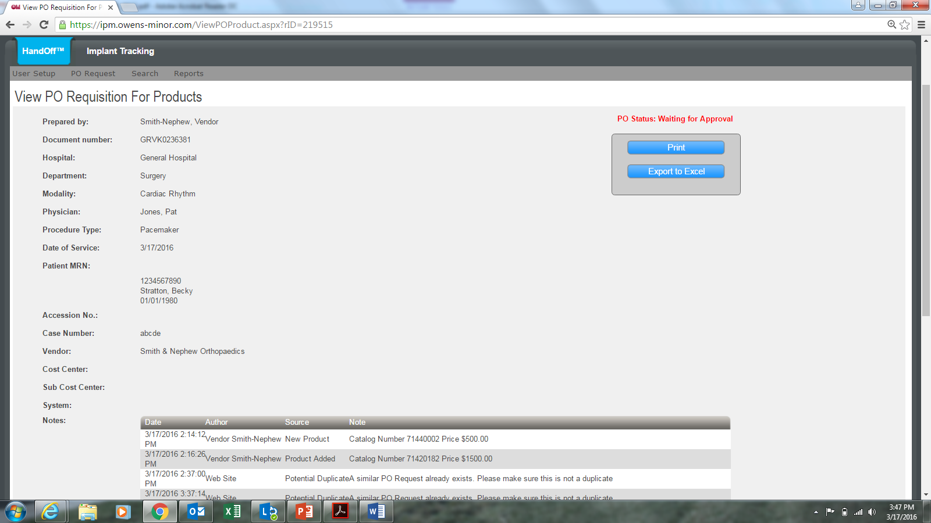
Once the Hospital has generated a PO Number, you will get an e-mail notification with that information. You can also see the PO Number displayed on the req in IPM.
If needed, a Vendor Roll-up view of all Reps using Implant Purchase Management is available.
*Contact IPM support at info@ipm.owens-minor.com for more information & training on this Vendor Customer Service Rep feature.

